Slide 1

Detailed Model Analysis for Betel Leaf Disease Classification
CSE366 – Sec 01 – Fall 2025

Slide 2
Team Members
Seendid Saleh Kabir
ID: 2022-1-60-122
Aditya Debnath
ID: 2022-2-60-124
Umme Habiba
ID: 2022-1-60-362
Md. Afridi
ID: 2022-3-60-080
Dr. Raihan Ul Islam,
Associate Professor,
East West University
Instructor

Slide 3
Introduction & Problem Statement
The Crop: Betel Leaf (Piper betle L.) is vital cash crop in South Asia.
The Problem: High susceptibility to diseases (Bacterial Spot, Foot Rot, Fungal Spot).
Current Solution: Manual visual inspection.
Limitations: Subjective, labor-intensive, prone to human error, requires experts.
Proposed Solution: Automated, precision driven diagnostic tool using Deep Learning.

Slide 4
Research Objectives
Benchmark: Evaluate standard Transfer Learning models against Custom CNNs.
Innovate: Develop and test a Hybrid CNN-Swin Transformer architecture.
Analyze: Compare the impact of Attention Mechanisms (CBAM, SE-Blocks).
Validate: Ensure robustness on imbalanced datasets and visualize decisions using XAI (Grad-CAM).

Slide 5
Evaluation Metrics & Protocol
Dataset: 1,000 Images (Balanced) + Secondary Imbalanced Test Set.
Hardware: CUDA-enabled GPPU (Tesla P100/T4)
Key Metrics Recorded:
Test Accuracy (%)
Training Time
Loss Convergence
Confusion Matrix Performance
Preprocessing: Resize (224x224), Normalization (ImageNet stats), Augmentation (Rotation, Flip, Color Jitter).

Slide 6
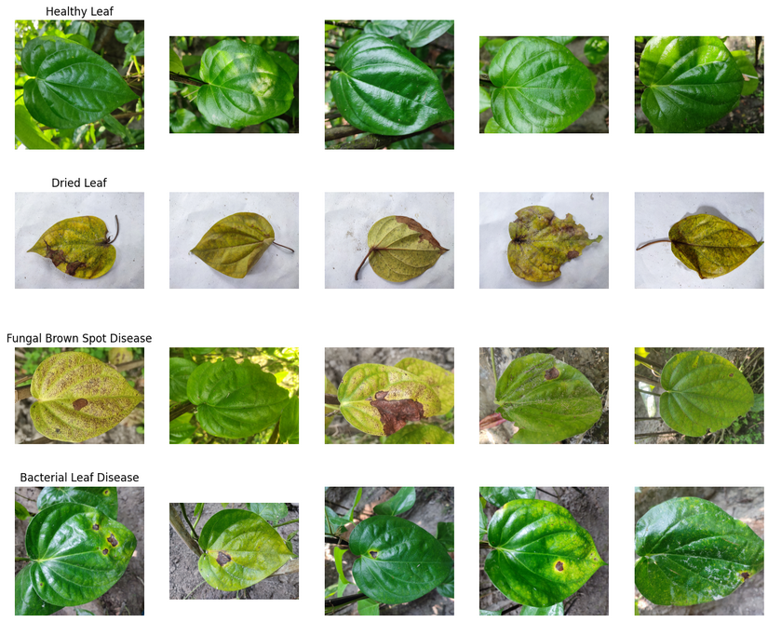
Dataset Overview
Source: Betal Leaf Image Dataset from Bangladesh.
Class (4): 1. Bacterial Leaf Disease 2. Dried Leaf 3. Fungal Brown Spot Disease 4. Healthy Leaf
Data Splits: Dataset 1 (Balanced): 1,000 images (250/class). Used for training. Dataset 2 (Imbalanced):** Real-world distribution (High variance in class counts). Used for robustness testing.
Preprocessing: Resize (224x224), Normalization (ImageNet stats), Augmentation (Rotation, Flip, Color Jitter).

Slide 7
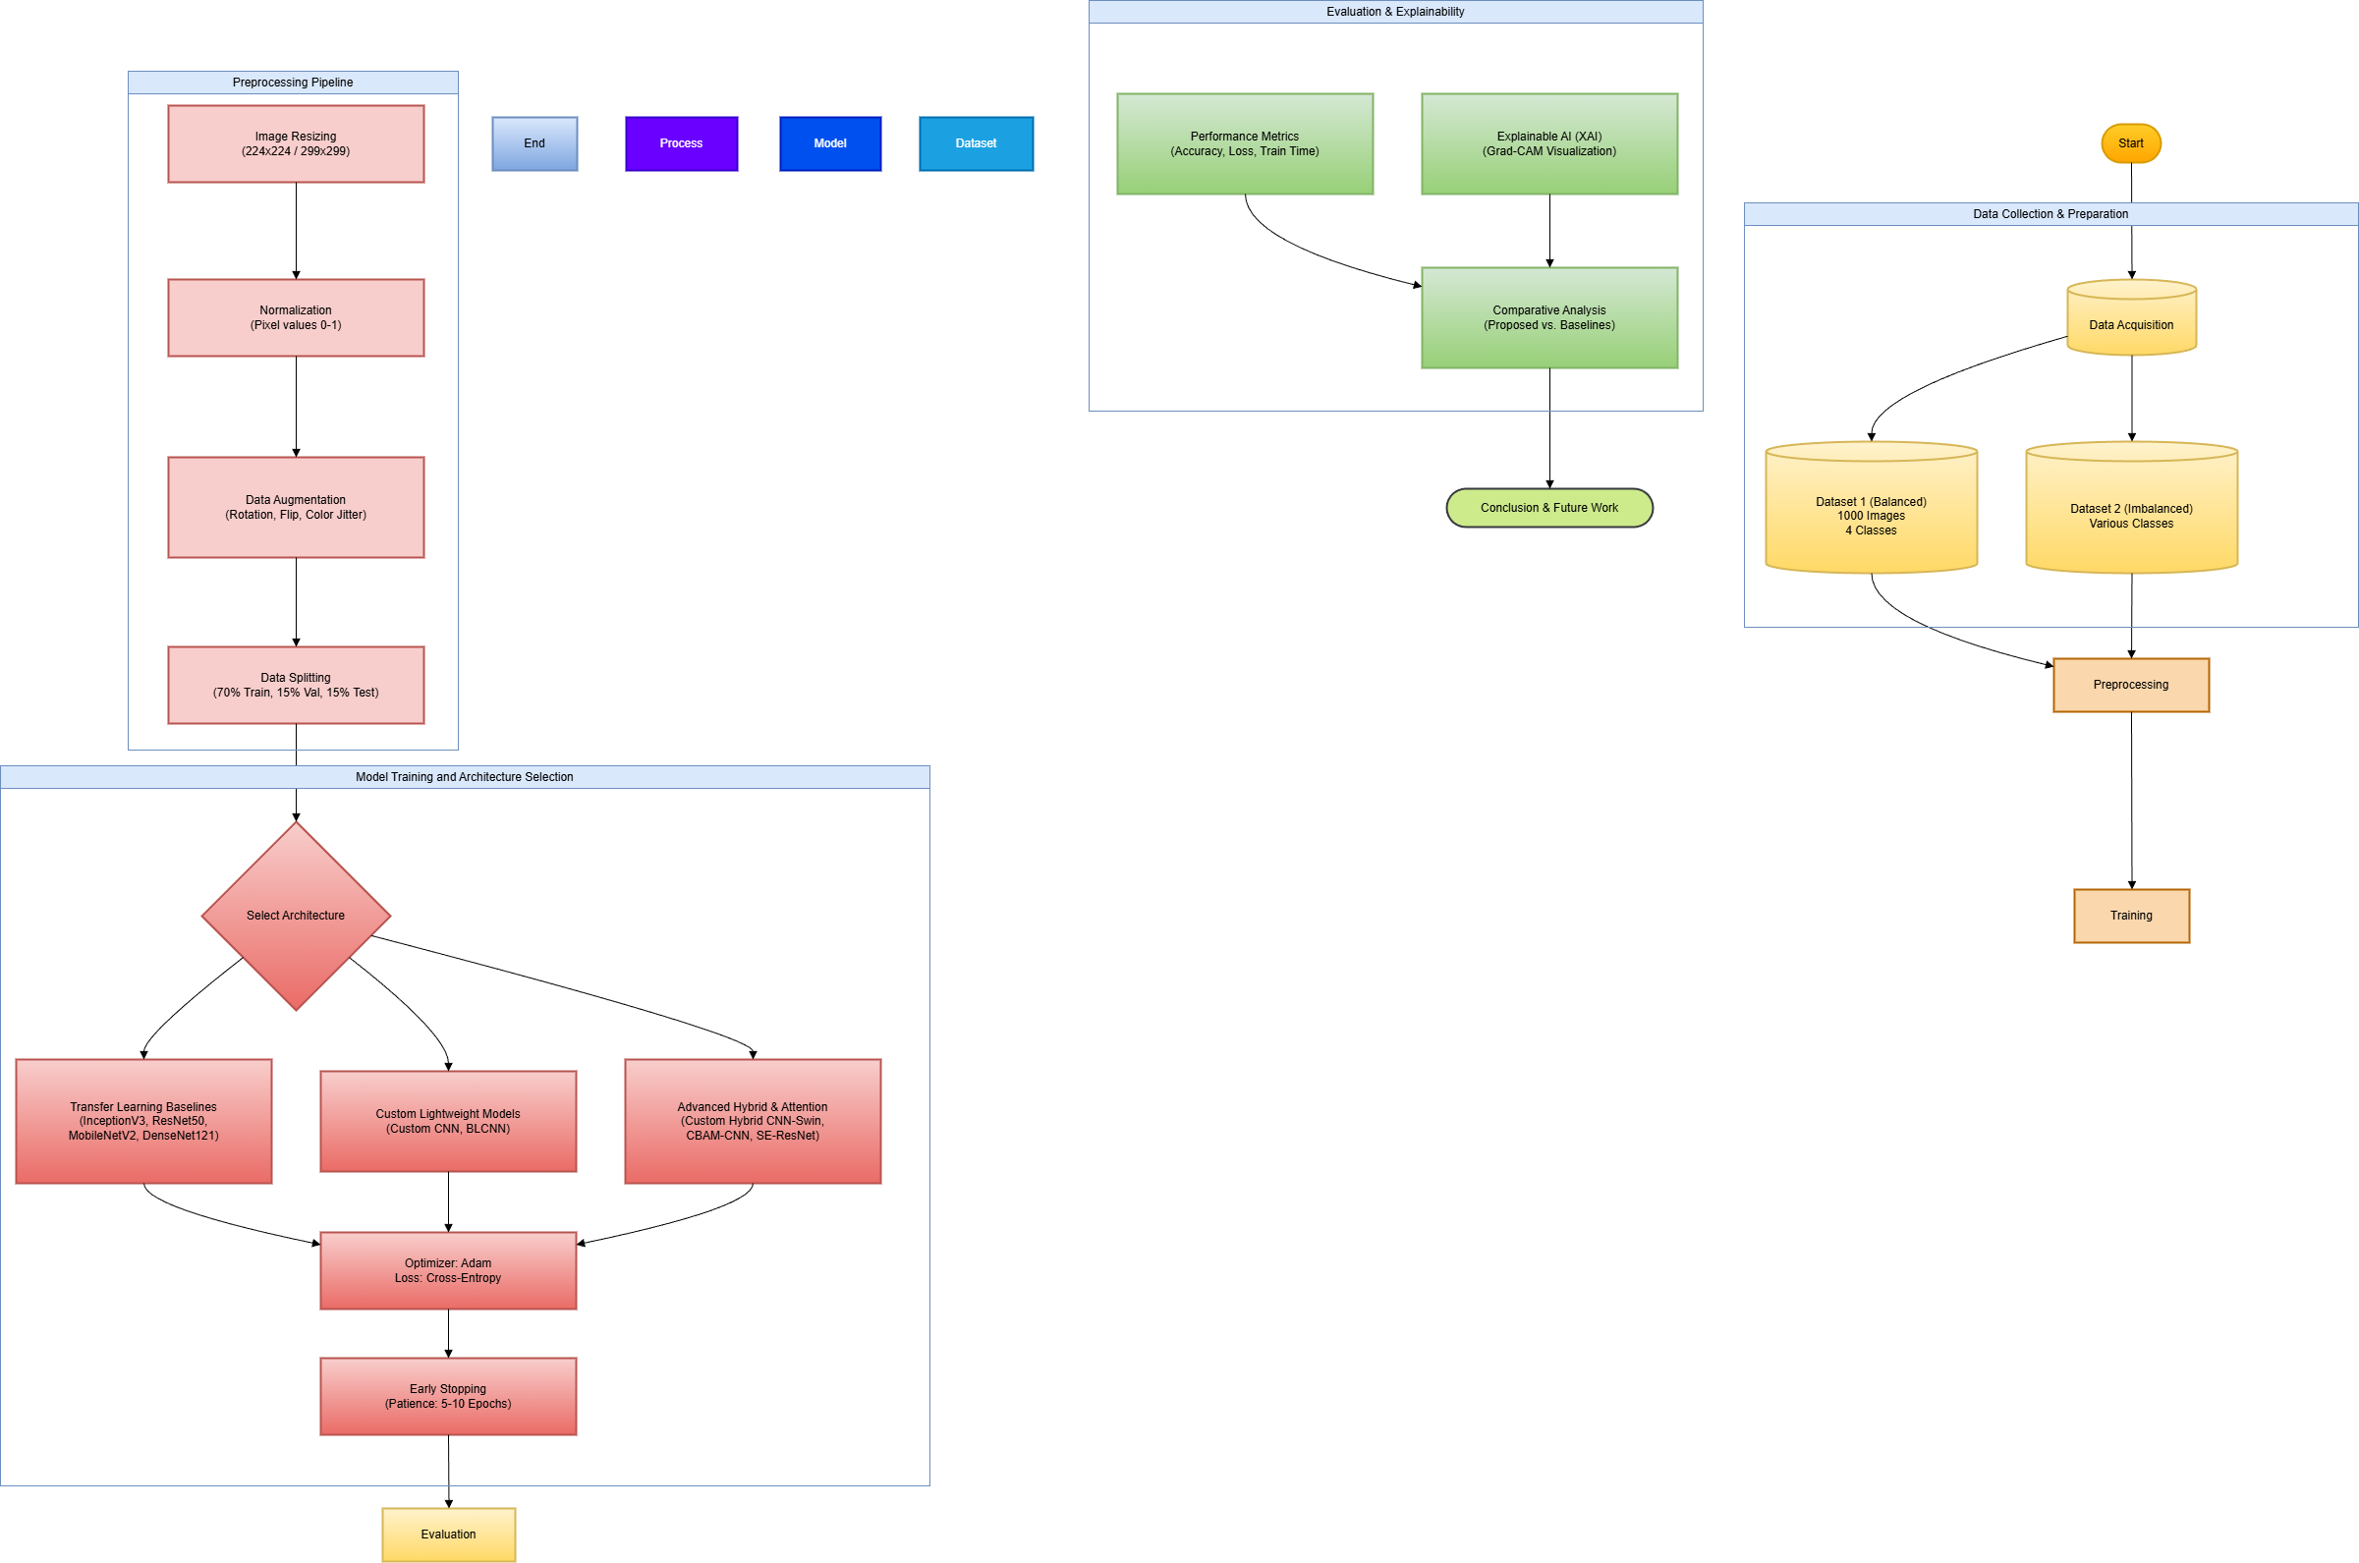
Methodology – The Models
Category 1: Transfer Learning Baselines
InceptionV3, ResNet50, MobileNetV2, DenseNet121, Xception, VGG16, AlexNet, EfficientNet-B0
Category 2: Custom Architectures
Custom Sequential CNN (Lightweight convolutions).
BLCNN (Depth-wise separable convolutions).
Category 3: Advanced Hybrid & Attention
Hybrid CNN-Swin Transformer: Combines local features (CNN) + global context (Transformer).
CBAM-CNN: Spatial + Channel Attention.
SE-ResNet: Squeeze-and-Excitation blocks.

Slide 8
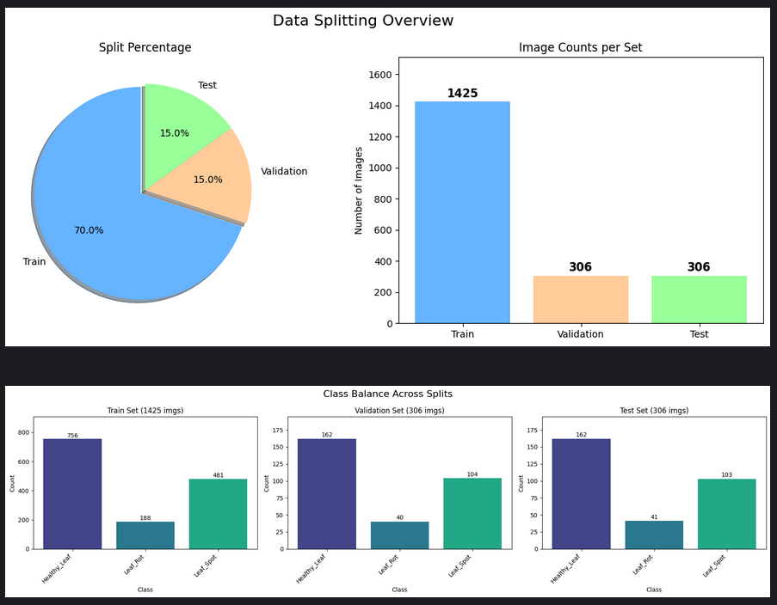
Proposed Architecture: Hybrid CNN-Swin Transformer
Key Components:
CNN Stem: Extracts low-level textural features (edges, shapes).
Swin Transformer Blocks: Captures long-range dependencies and global context using shifted windows.
Classification Head: Global Average Pooling +Dense Layers.
Picture of data splitting on the Dataset 2.

Slide 9
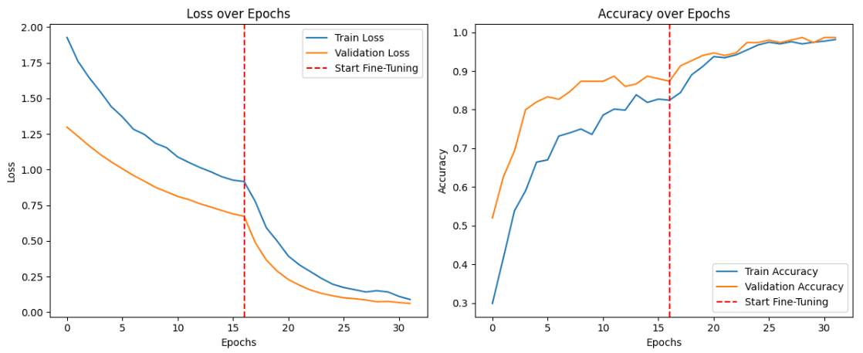
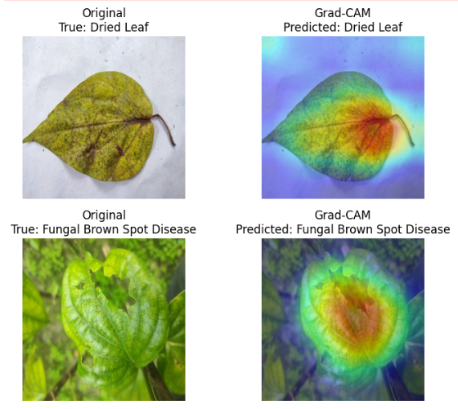
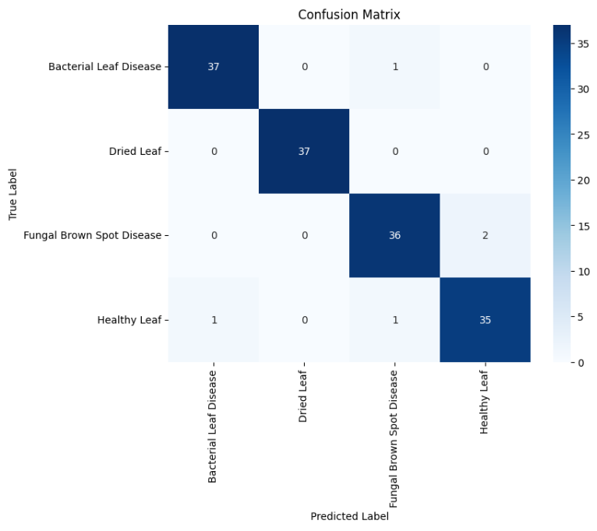
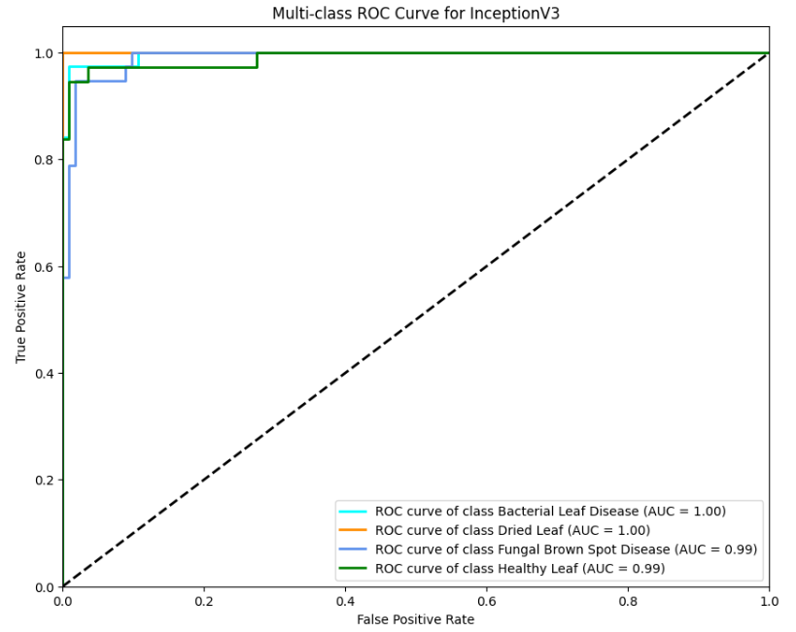
Section 1: Transfer Learning Baselines
Experimental Result
Evaluating industry-standard pre-trained architectures.
Model 1 – InceptionV3
Architecture Type: Deep CNN with Inception Modules (Multi-scale processing).
Training Configuration: Transfer Learning (ImageNet weights), Fine-tuned.
Performance:
Accuracy: 96.7% (Top Performer in Baselines)
Training Time: ~3.09 mins
Analysis:
Excellent generalization.
The multi-scale filters allowed it to detect disease spots of varying sizes effectively.
Verdict: Best standard CNN for this task.

Slide 10
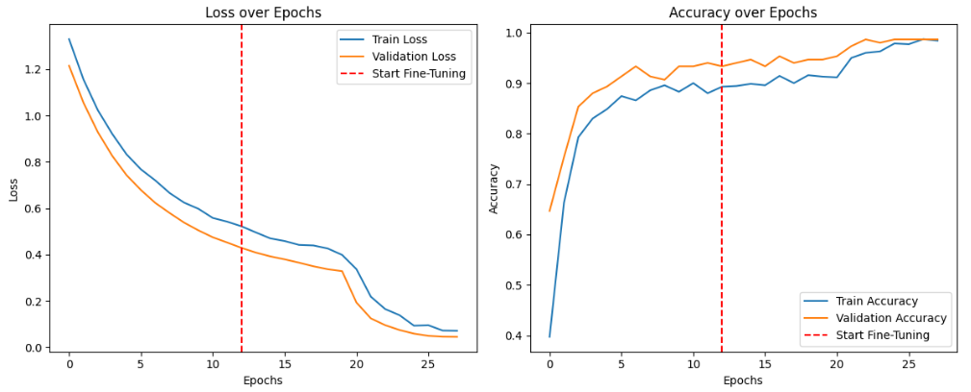
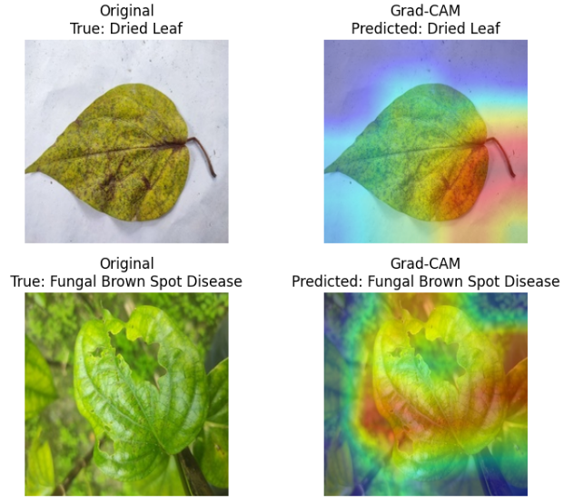
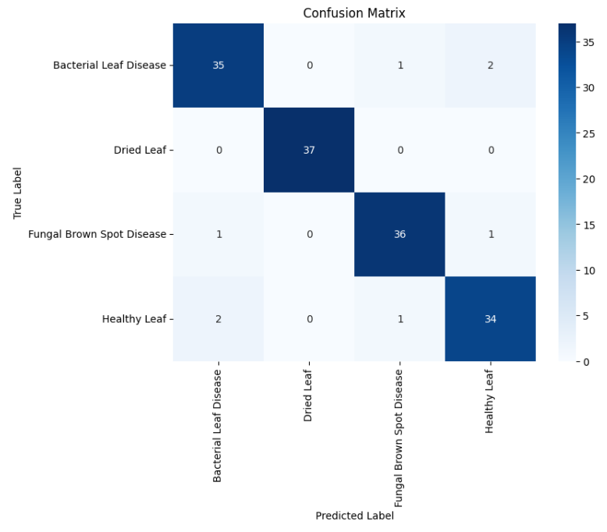
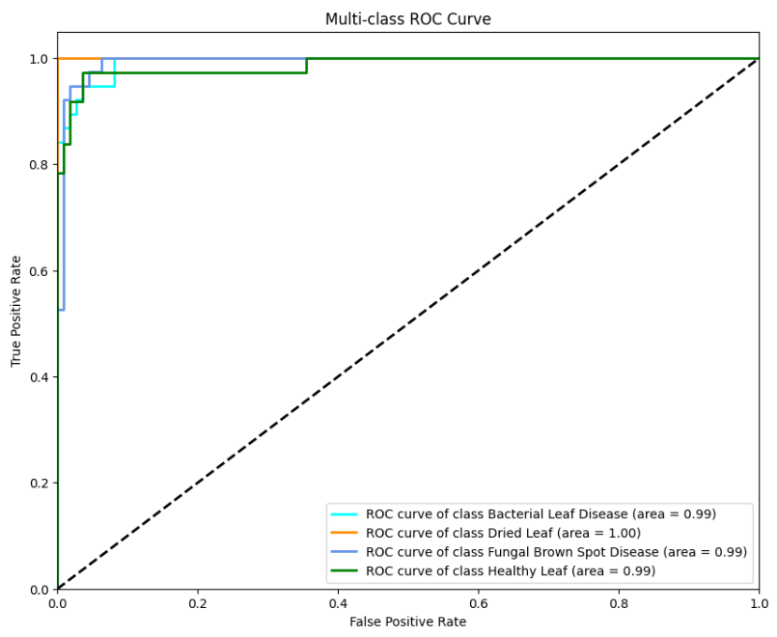
Model 2 – ResNet50
Architecture Type: Residual Network (50 layers) with skip connections.
Training Configuration: Pre-trained, Early Stopping enabled.
Performance:
Accuracy: 95.0%
Training Time: ~1.56 mins
Analysis:
Very fast convergence.
Solved vanishing gradient issues effectively.
Verdict: Highly reliable and efficient, second only to InceptionV3 among baselines.

Slide 11
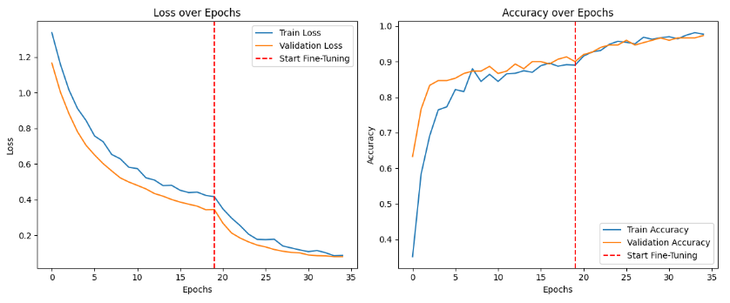
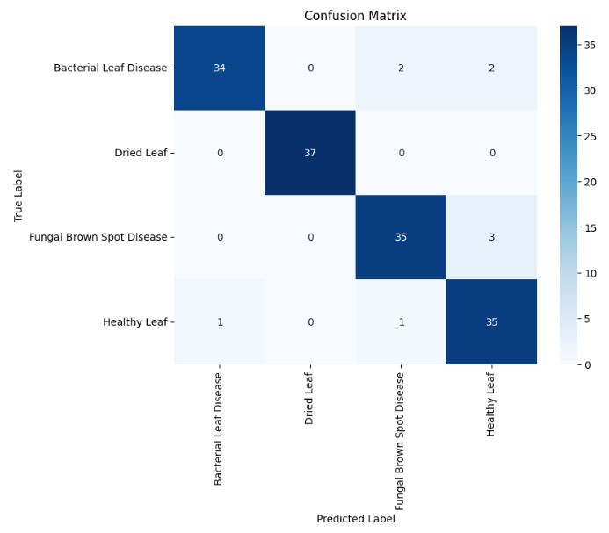
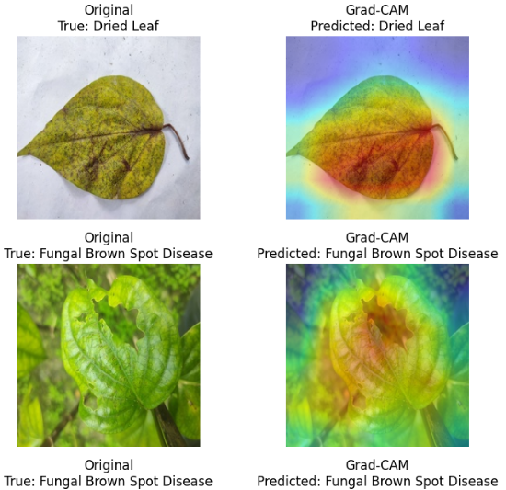
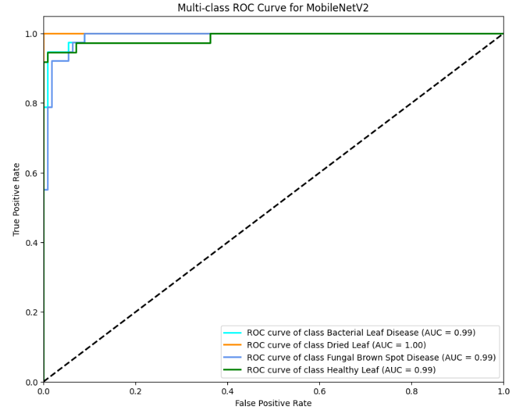
Model 3 – MobileNetV2
Architecture Type: Lightweight CNN with Depth-wise Separable Convolutions.
Training Configuration: Standard Transfer Learning.
Performance:
Accuracy: 94.0%
Training Time: ~1.44 mins
Analysis:
Designed for mobile devices; extremely low latency.
Performed comparably to the much heavier RedNet50
Verdict: Ideal candidate for mobile app deployment if resources are tight.

Slide 12
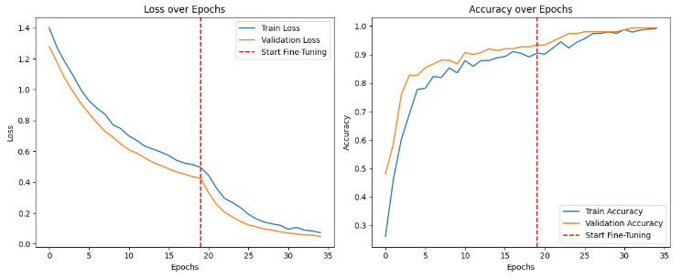
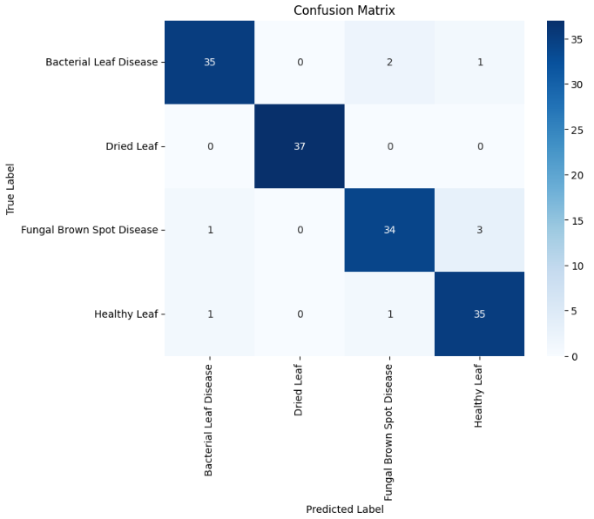
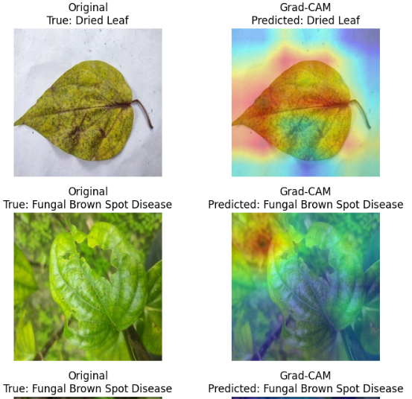
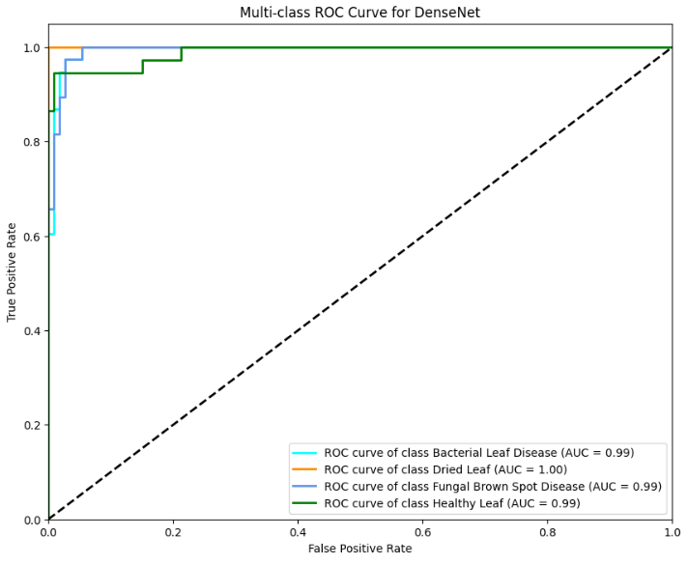
Model 4 – DenseNet121
Architecture Type: Densely Connected Convolutional Network.
Training Configuration: Fine-tuned (Unfrozen deeper layers).
Performance:
Accuracy: 94.0%
Training Time: ~131 seconds (Higher computational cost).
Analysis:
Feature reuse makes it powerful but computationally expensive.
Did not significantly outperform MobileNet despite higher complexity.
Verdict: Good accuracy, but diminishing returns on efficiency.

Slide 13
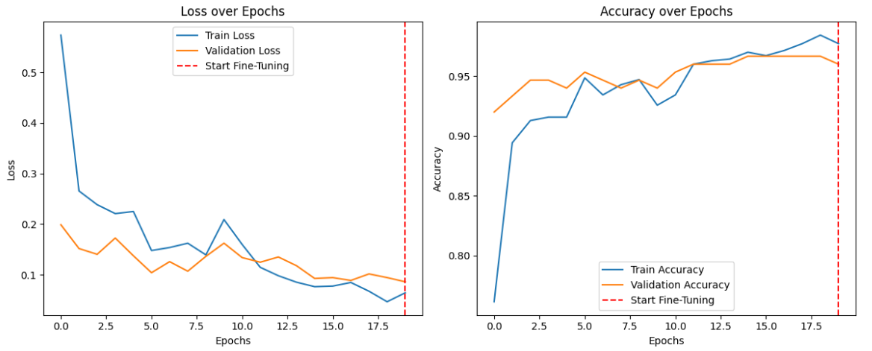
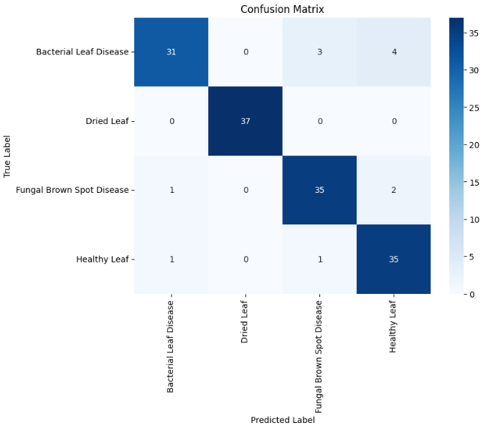
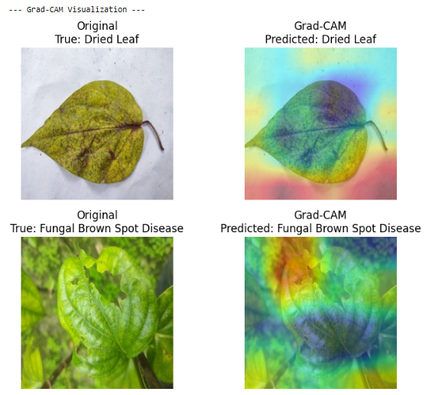

Model 5 – AlexNet
Architecture Type: Classic shallow CNN (Large filters).
Training Configuration: Pre-trained on ImageNet.
Performance:
Accuracy: 92.0%
Training Time: ~50 seconds (Very Fast).
Analysis:
Surprise Finding: Outperformed modern architectures like EfficientNet and Xception.
Simpler inductive biases worked well for the specific morphological features of betel leaves.
Verdict: Proof that older, simpler models can still be effective on smaller datasets.

Slide 14
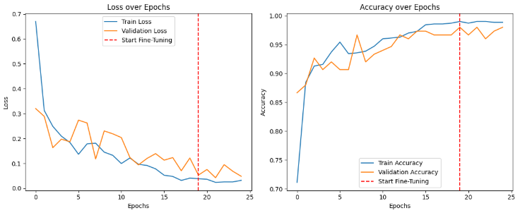
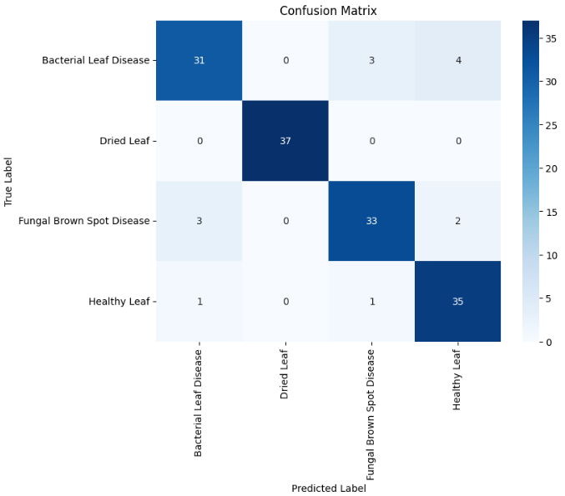
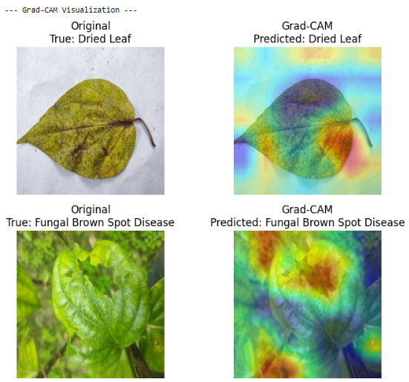
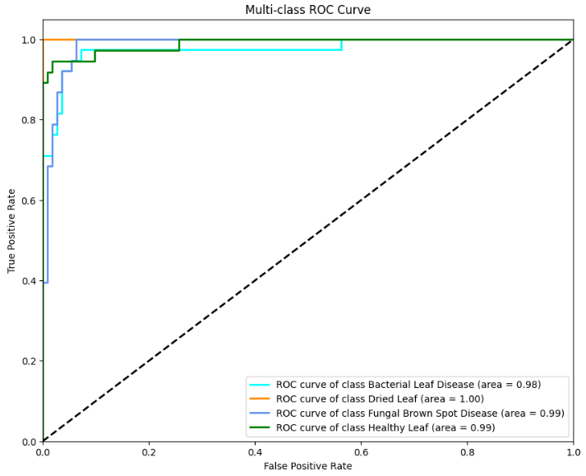
Model 6 – VGG16
Architecture Type: Very Deep Convolutional Network (16 layers).
Training Configuration: Transfer Learning.
Performance:
Accuracy: 91.0%
Training Time: ~2.19 mins
Analysis:
High parameter count made it slower to train than ResNet.
Solid feature extractor, but prone to overfitting without heavy regularization.
Verdict: Decent performance, but outdated efficiency.

Slide 15
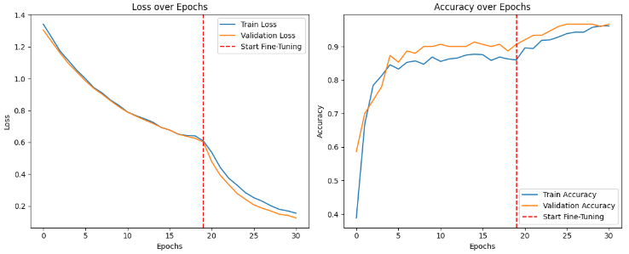
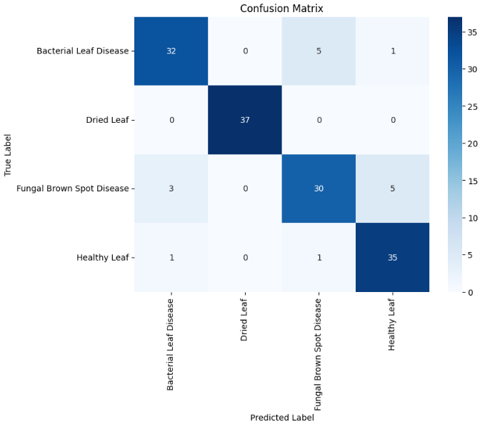
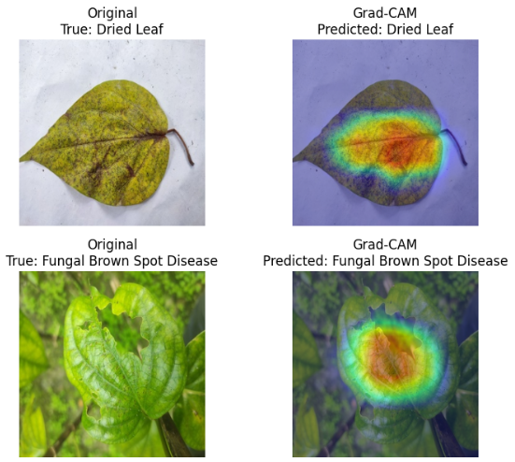
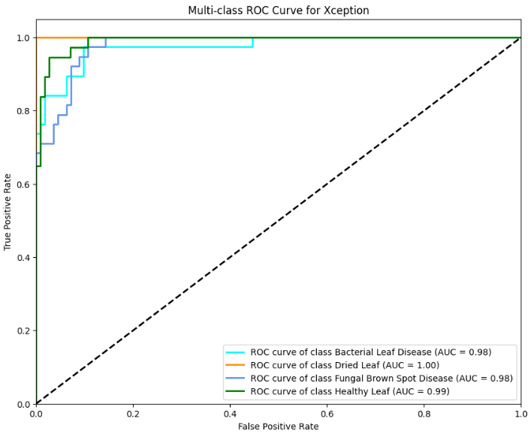
Model 7 – Xception
Architecture Type: Extreme Inception (Depth-wise separable convs).
Training Configuration: Fine-tuned with Early Stopping.
Performance:
Accuracy: 89.0%
Training Time: ~242 seconds (Slowest among baselines).
Analysis:
Struggled to generalize compared to InceptionV3.
High training time suggested optimization difficulties on this specific dataset.
Verdict: Underperformed relative to expectations.

Slide 16
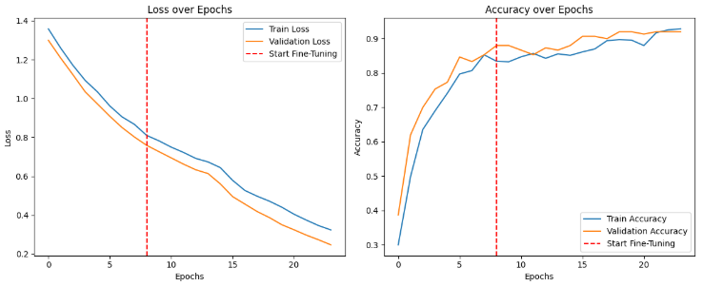
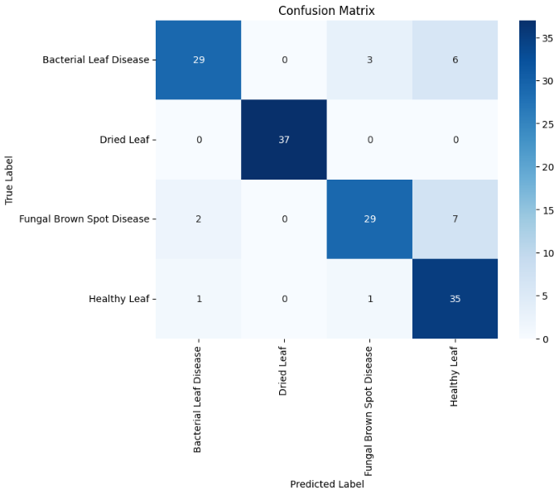
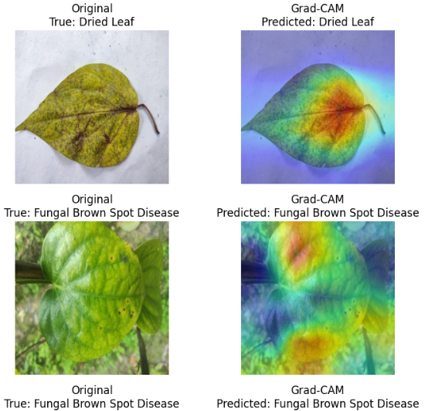
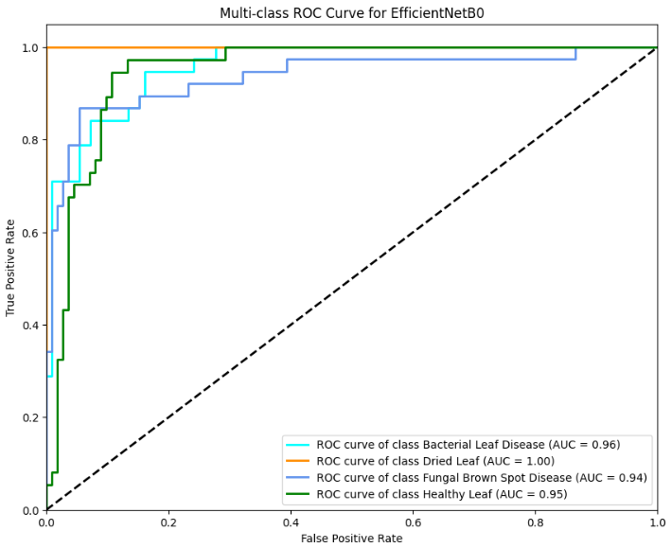
Model 8 – EfficientNet-B0
Architecture Type: Compound Scaling CNN.
Training Configuration: Transfer Learning.
Performance:
Accuracy: 87.0%
Training Time: ~1.16 mins
Analysis:
Lowest performance among transfer learning models.
Likely required more extensive hyperparameter tuning or a larger dataset to leverage its scaling capabilities.
Verdict: Not suitable for this specific dataset configuration.

Slide 17
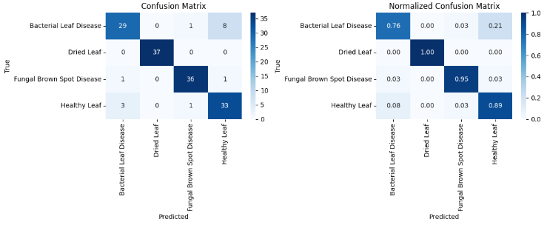
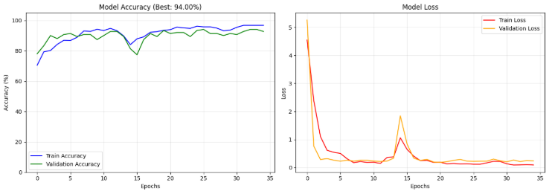
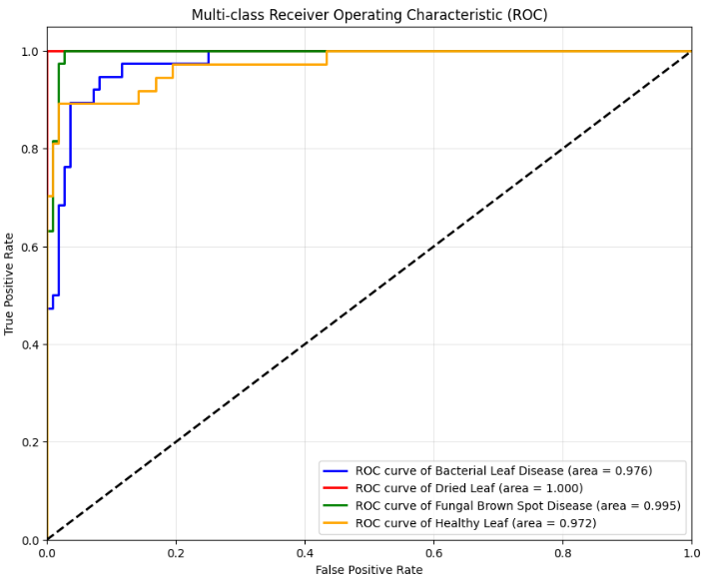
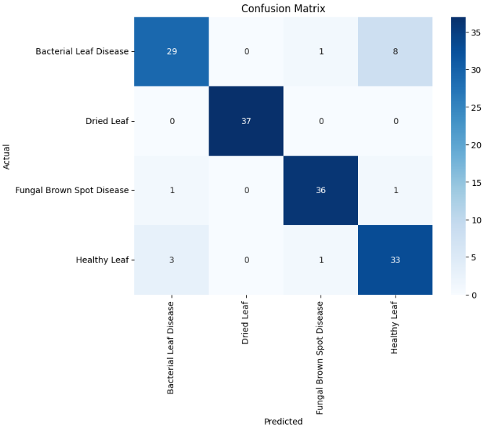
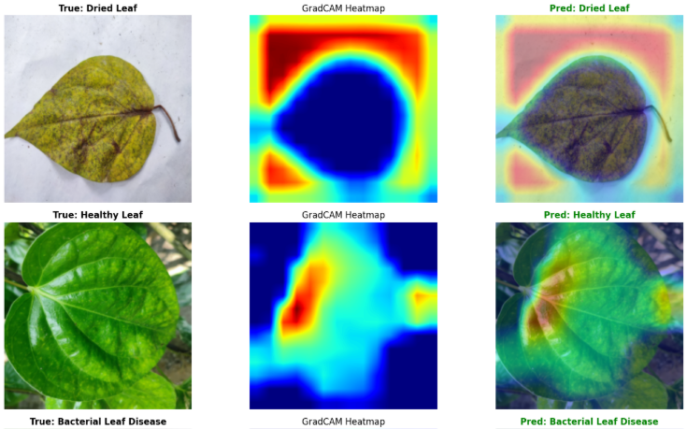
Section 2: Custom Architectures
Evaluating models built from scratch.
Model 9 – Custom Sequential CNN
Architecture Type: Standard CNN (Conv2D -> ReLU -> MaxPool).
Training Configuration: Trained from scratch (35 Epochs).
Performance:
Accuracy: 90.0%
Training Time: ~20 seconds (Fastest).
Analysis:
Strong baseline performance.
Lacked the ability to capture fine-grained textures distinguishing bacterial vs. fungal spots.
Verdict: Good starting point, but limited.

Slide 18
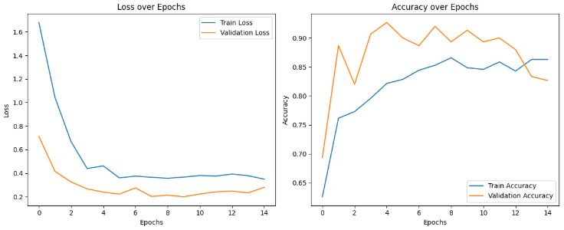
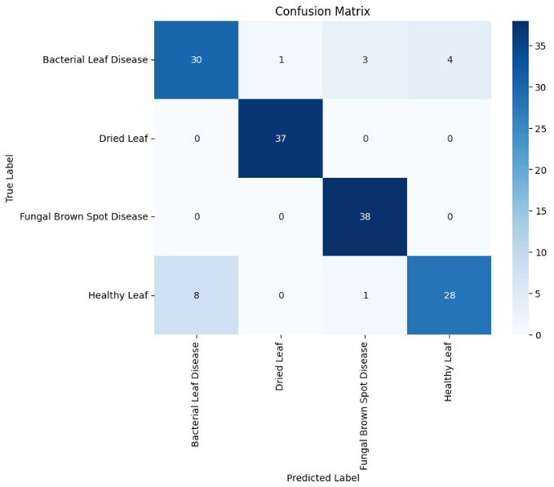
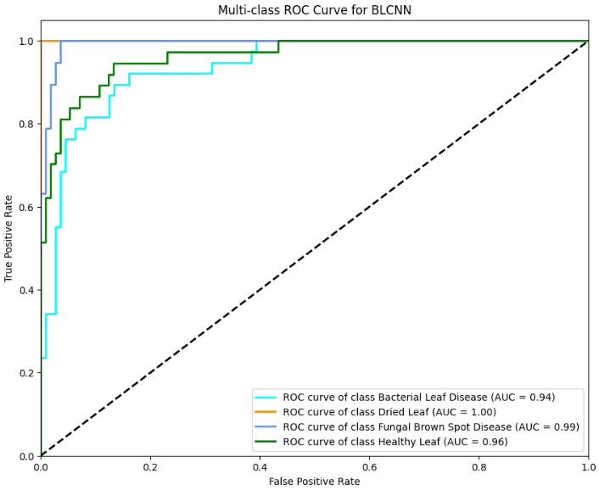
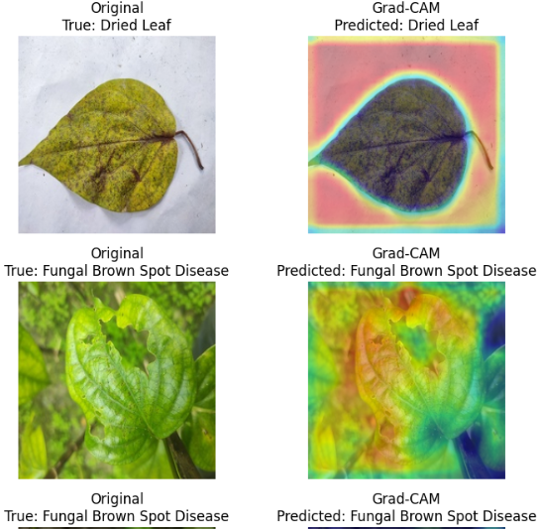
Model 10 – BLCNN (Betel Leaf CNN)
Architecture Type: Domain-specific custom architecture (based on literature).
Training Configuration: Trained from scratch.
Performance:
Accuracy: 88.87%
Training Time: ~31 seconds.
Analysis:
Performed slightly worse than the standard Custom CNN.
Indicates that the specific architectural tweaks from literature didn’t transfer perfectly to our dataset split.
Verdict: Less effective than standard designs.

Slide 19
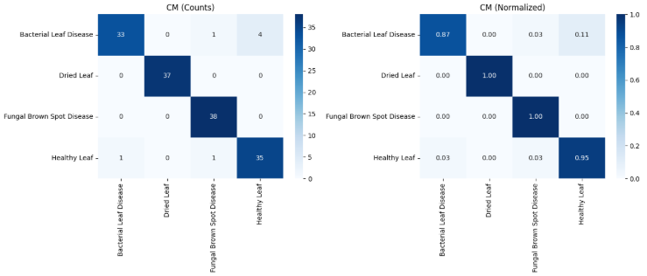
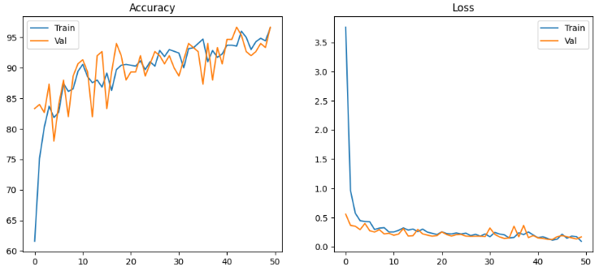
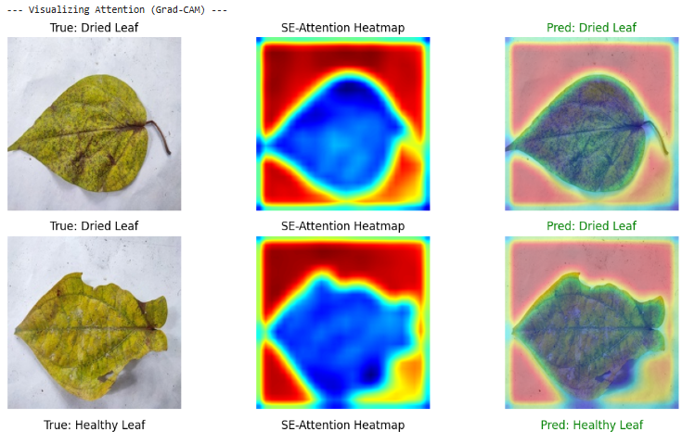
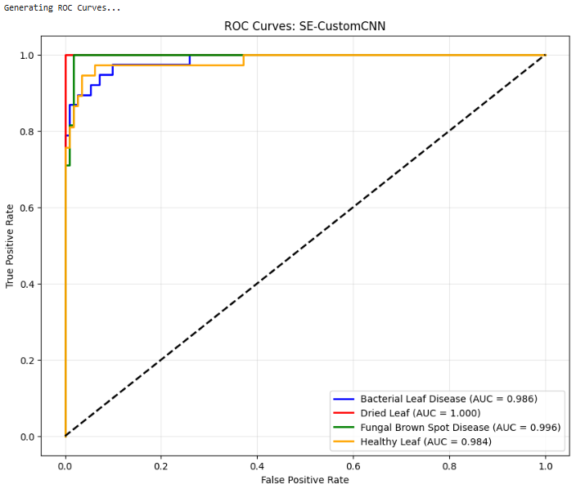
Section 3: Advanced Attention & Hybrid Models
The State-of-Art Contenders.
Model 11 – SE-Custom CNN
Architecture Type: Custom CNN + Squeeze-and-Excitation (SE) Blocks.
Mechanism: Channel-wise attention (Recalibrates feature maps).
Performance:
Accuracy: 95.0%
Training Time: ~6 minutes 47 seconds
Improvement: +5% over standard Custom CNN.
Analysis:
.Demonstrated that channel attention significantly boosts feature extraction in lightweight models.
Lacked the ability to capture fine-grained textures distinguishing bacterial vs. fungal spots.
Verdict: Excellent balance of custom design and high accuracy.

Slide 20
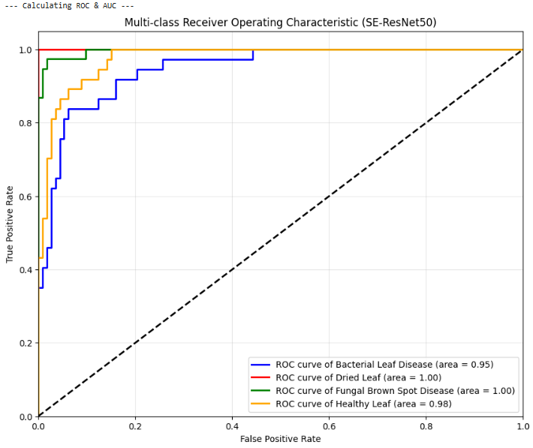
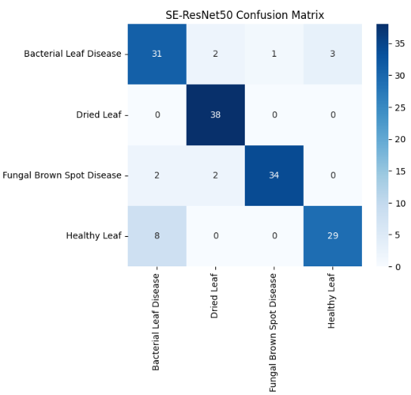
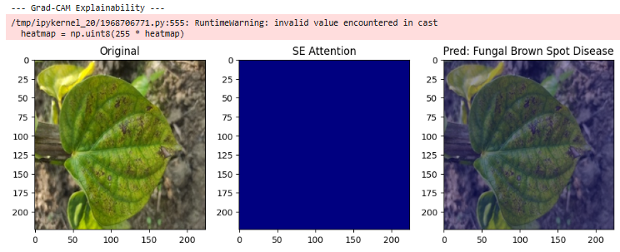
Model 12 – SE-ResNet
Architecture Type: ResNet backbone + SE Blocks.
Performance:
Accuracy: 88.0%
Training Time: ~7 minutes 26 seconds
Analysis:
Surprisingly underperformed compared to the SE-Custom CNN.
Suggests that simply adding attention to a heavy backbone doesn’t guarantee success without careful tuning.
Verdict: Disappointing implementation compared to custom SE.

Slide 21




Model 13 – CBAM-CNN
Architecture Type: CNN + Convolutional Block Attention Module.
Mechanism: Spatial Attention (“Where to look”) + Channel Attention (“What to look for”).
Performance:
Accuracy: 97.33%
Training Time: ~25 seconds.
Analysis:
Outperformed all pure CNNs (including InceptionV3).
Spatial attention helped the model ignore background noise and focus purely on leaf lesions.
Verdict: The Best pure CNN-based attention model.

Slide 22




Model 14 – Hybrid CNN-Swin Transformer
Architecture Type: CNN Stem (Local features) + Swin Transformer Blocks (Global context).
Performance:
Accuracy (Dataset 1): 98.0%
Training Time: ~ 8 minutes 31 seconds
Accuracy (Dataset 2 - Imbalanced): 93.0%
Analysis:
Synergy: CNN captures edge; Transformer captures the holistic leaf structure.
Robustness: Maintained high accuracy even on the difficult, imbalanced dataset..
Verdict: State-of-the-Art Performance. The recommended model for deployment.

Slide 23

Robustness & Generalization
Tested on Dataset 2 (Imbalanced). Challenge : Standard models Transformer maintained 93% accuracy on the imbalanced dataset.
Result: The Hybrid Swin Transformer maintained 93% accuracy on the imbalanced dataset.
Conclusion: The Hybrid model is not just accurate; it is robust for real-world scenarios.

Slide 24

Discussion – Architecture Insights
InceptionV3 : Best pure CNN. Multi-sacle processing helped detect disease spots of varying sizes.
AlexNet (92%) : Surprisingly beat modern EfficientNet (87%). Reason : Simpler inductive biases (larger filters) worked better for this specific small dataset than complex compound scaling.
Attention Mechanisms : CBAM and SE blocks consistently improved performance over base model by focusing on “where” the disease is.

Slide 25
Explainable AI (Grad-CAM)
Visuals.
Goal: Open the “Black Box.”
Observation:
Hybrid/CBAM: Heatmaps focus tightly on lesions and necrotic spots.
Weaker Models: Validates clinical reliability for precision agriculture.

Slide 26
Conclusion & Future Work
Conclusion : InceptionV3 is the most efficient standard model. Hybrid CNN-Swin Transformer is the state-of-state-art (98%) for this task. Integrating local and global attention is key for plant disease diagnosis.
Future Work :
Mobile Deployment : Model quantization for edge devices.
Segmentation : Moving from classification to segmentation (U-Net) to measure infection severity.
Dataset Expansion : More lighting conditions and disease types.

Slide 27
Final Comparative Summary
Rank | Model Name | Test Accuracy | Architecture Type | Training Time
1 | Hybrid CNN-Swin Transformer | 98.00% | Hybrid Transformer | 8m 31s
2 | CBAM-CNN | 97.33% | Attention CNN | ~25s
3 | InceptionV3 | 97.00% | Transfer Learning | 3.09m
4 | SE-Custom CNN | 95.00% | Attention CNN | 6m 47s
5 | ResNet50 | 94.00% | Transfer Learning | 1.56m
6 | MobileNetV2 | 94.00% | Transfer Learning | 1.44m
7 | DenseNet121 | 94.00% | Transfer Learning | 2.19m
8 | AlexNet | 91.00% | Transfer Learning | ~50s

Slide 28
Thank you
Reference of the dataset
Dataset 1 (Balanced) link: https://data.mendeley.com/datasets/g7fpgj57wc/2
Dataset 2 (Imbalanced) link: https://data.mendeley.com/datasets/vpzkntzjty/1

